Slide 1
Descriptive Statistics
Measures of Central Tendency
Variability
Standard Scores

Slide 2
What is TYPICAL???
Average ability
conventional circumstances
typical appearance
most representative
ordinary events

Slide 3
Measure of Central Tendency
What SINGLE summary value best describes the central location of an entire distribution?

Slide 4
Three measures of central tendency (average)
Mode: which value occurs most (what is fashionable)
Median: the value above and below which 50% of the cases fall (the middle; 50th percentile)
Mean: mathematical balance point; arithmetic mean; mathematical mean

Slide 5
Mode
For exam data, mode = 37 (pretty straightforward) (Table 4.1)
What if data were
  17, 19, 20, 20, 22, 23, 23, 28
Problem: can be bimodal, or trimodal, depending on the scores
Not a stable measure

Slide 6
Median
For exam scores, Md = 34
What if data were
  17, 19, 20, 23, 23, 28
Solution:
Best measure in asymmetrical distribution (ie skewed), not sensitive to extreme scores

Slide 7
Nomenclature
X is a single raw score
X_{i} is to the i ^{th} score in a set
X _{n} is the last score in a set
Set consists of X ₁ , X ₂ ,….X_{n}
∑ X = X ₁ + X ₂ + …. + X _{n}

Slide 8
Mean
For Exam scores, X = 33.94
  Note: X = a single score
Mathematically: X = ∑ X / N
  the sum of scores divided by the number of cases
  Add up the numbers and divide by the sample size
Try this one: 5,3,2,6,9

Slide 9
Characteristics of the Mean
Balance point
  point around which deviation scores sum to zero

Slide 10
Characteristics of the Mean
Balance point
  point around which deviation scores sum to zero
  Deviation score: X_{i} - X
  ie Scores 7, 11, 11, 14, 17
    X = 12
    ∑ (X - X) = 0

Slide 11
Characteristics of the Mean
Balance point
Affected by extreme scores
  Scores 7, 11, 11, 14, 17
  X = 12, Mode and Median = 11
  Scores 7, 11, 11, 14, 170
  X = 42.6, Mode & Median = 11
Considers value of each individual score

Slide 12
Characteristics of the Mean
Balance point
Affected by extreme scores
Appropriate for use with interval or ratio scales of measurement
  Likert scale??????????????????

Slide 13
Characteristics of the Mean
Balance point
Affected by extreme scores
Appropriate for use with interval or ratio scales of measurement
More stable than Median or Mode when multiple samples drawn from the same population

Slide 14
Three statisticians out deer hunting
First shoots arrow, sticks in tree to right of the buck
Second shoots arrow, sticks in tree to left of the buck
Third statistician….

Slide 15
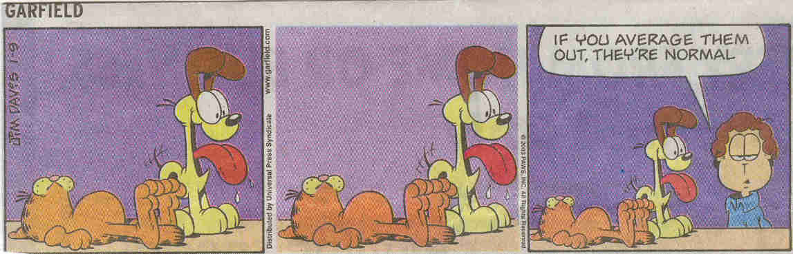
More Humour

Slide 16
In Class Assignment
Using the 33 scores that make up exam scores (table 4.1)
students randomly choose 3 scores and calculate mean
WHAT GIVES??

Slide 17
Guidelines to choose Measure of Central Tendency
Mean is preferred because it is the basis of inferential stats
  Considers value of each score

Slide 18
Guidelines to choose Measure of Central Tendency
Mean is preferred because it is the basis of inferential stats
Median more appropriate for skewed data???
  Doctor’s salaries
  George Will Baseball(1994)
  Hygienist’s salaries

Slide 19
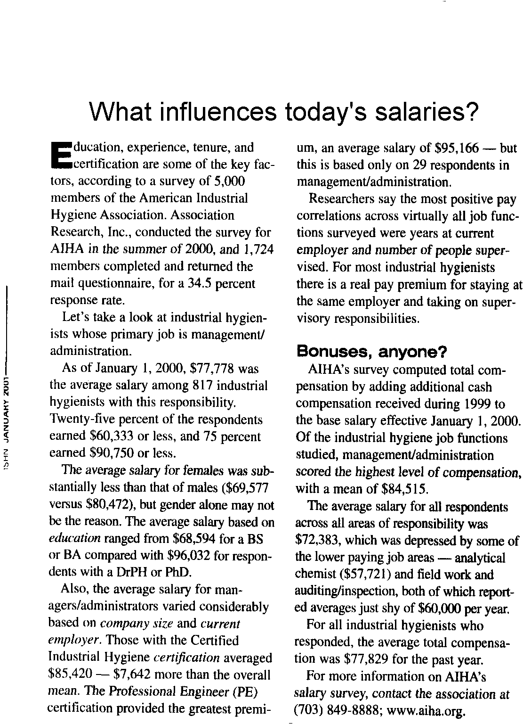
To use mean, data distribution must be symmetrical

Slide 20
Normal Distribution
Mode
Median
Mean
Scores

Slide 21
Positively skewed distribution
Mode
Median
Mean
Scores

Slide 22
Negatively skewed distribution

Slide 23
Guidelines to choose Measure of Central Tendency
Mean is preferred because it is the basis of inferential statistics
Median more appropriate for skewed data???
Mode to describe average of nominal data (Percentage)

Slide 24
Did you know that the great majority
of people have more than the average
number of legs? It's obvious really;
amongst the 57 million people in Britain
there are probably 5,000 people who
have got only one leg. Therefore
the average number of legs is:

Slide 25
Mean = ((5000 * 1) + (56,995,000 * 2)) / 57,000,000
= 1.9999123
Since most people have two legs...

Slide 26
Final (for now) points regarding MCT
Look at frequency distribution
  normal? skewed?
Which is most appropiate??
f
Time to fatigue

Slide 27
Alaska’s average elevation of
1900 feet is less than that of Kansas.
Nothing in that average suggests
the 16 highest mountains in
the United States are in Alaska.
Averages mislead, don’t they?
Grab Bag, Pantagraph, 08/03/2000

Slide 28
Mean may not represent any actual case in the set
Kids Sit up Performance
  36, 15, 18, 41, 25
What is the mean?
Did any kid perform that many sit-ups????

Slide 29
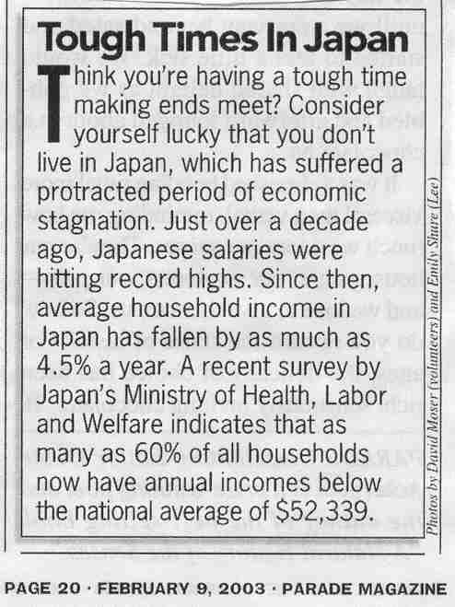
Describe the distribution of Japanese salaries.

Slide 30
Variability defined
Measures of Central Tendency provide a summary level of group performance
Recognize that performance (scores) vary across individual cases (scores are distributed)
Variability quantifies the spread of performance (how scores vary)
  parameter or statistic

Slide 31
To describe a distribution
N (n)
Measure of Central Tendency
  Mean, Mode, Median
Variability
  how scores cluster
  multiple measures
    Range, Interquartile range
    Standard Deviation

Slide 32
The Range
Weekly allowances of son & friends
  2, 5, 7, 7, 8, 8, 10, 12, 12, 15, 17, 20
Everybody gets $12; Mean = 10.25

Slide 33
The Range
Weekly allowances of son & friends
  2, 5, 7, 7, 8, 8, 10, 12, 12, 15, 17, 20
Range = (Max - Min) Score
  20 - 2 = 18
Problem: based on 2 cases

Slide 34
The Range
Allowances
  2, 5, 7, 7, 8, 8, 10, 12, 12, 15, 17, 20
Susceptible to outliers
Allowances
  2, 2, 2, 3, 4, 4, 5, 5, 5, 6, 7, 20
Range = 18
Mean = 10.25
Outlier
Mean = 5.42

Slide 35
Semi-Interquartile range
What is a quartile??

Slide 36
Semi-Interquartile range
What is a quartile??
  Divide sample into 4 parts
  Q₁ , Q₂ , Q₃ => Quartile Points
Interquartile Range = Q ₃ - Q ₁
SIQR = IQR / 2
Related to the Median
Calculate with atable12.sav data, output on next overhead

Slide 37
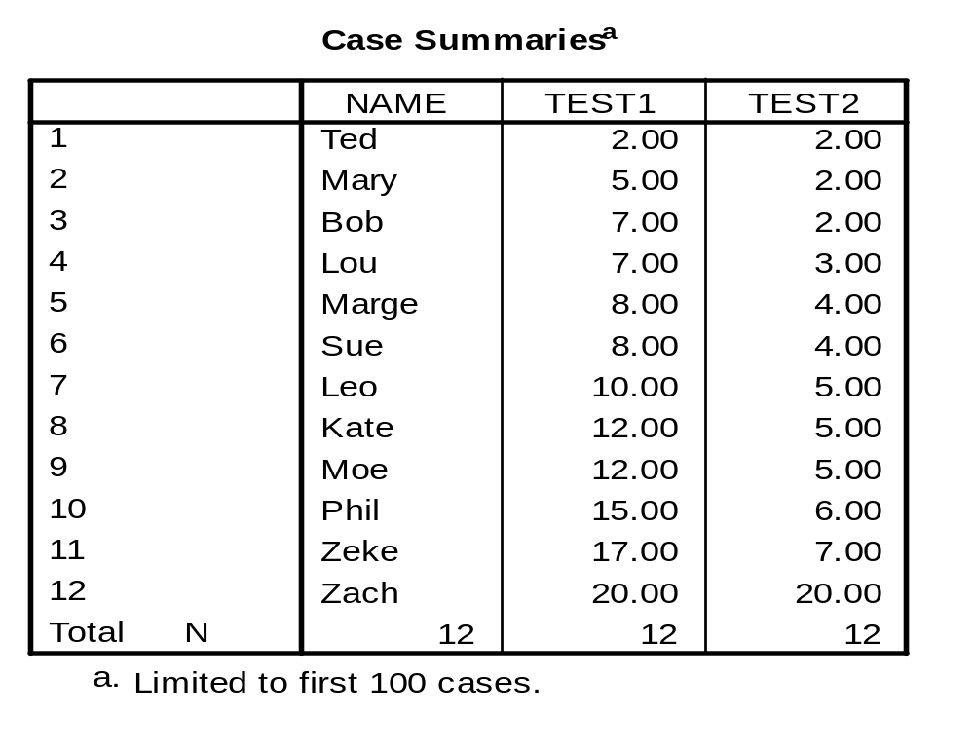
Atable12.sav

Slide 38
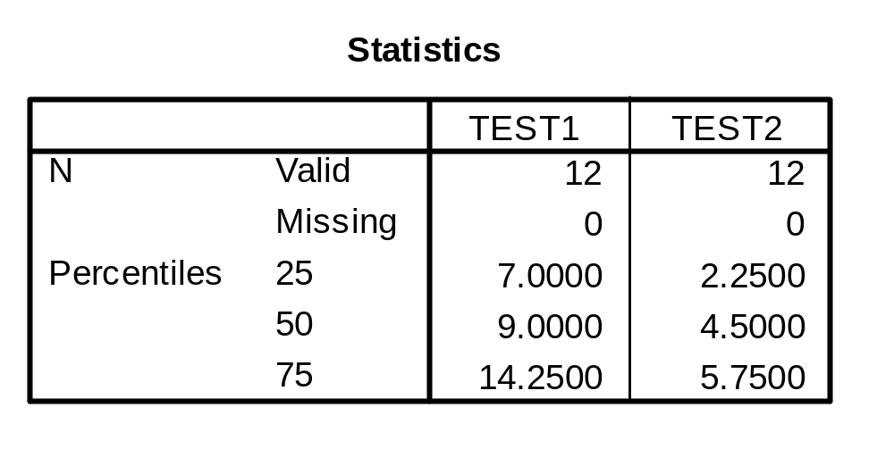
Quartiles of Test 1 & Test 2
(Procedure Frequencies on SPSS)
Calculate inter-quartile range for Test 1 and Test 2

Slide 39
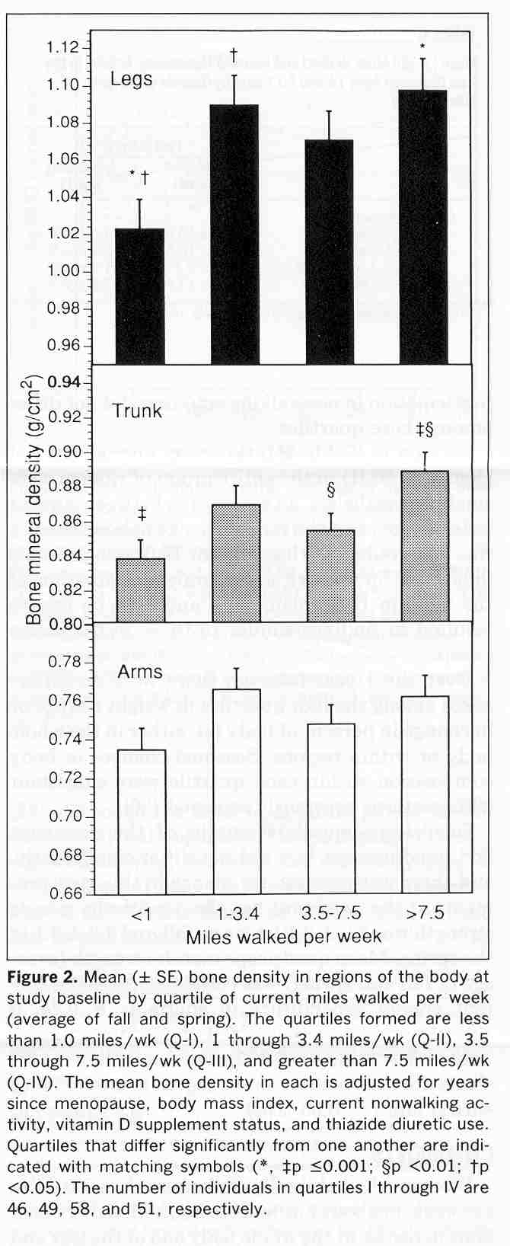
BMD and walking
Quartiles based on miles walked/week
Krall et al, 1994, Walking is related to bone density and rates of bone loss. AJSM, 96:20-26

Slide 40
Standard Deviation
Statistic describing variation of scores around the mean
Recall concept of deviation score

Slide 41
Standard Deviation
Statistic describing variation of scores around the mean
Recall concept of deviation score
  DS = Score - criterion score
  x = Raw Score - Mean
What is the sum of the x’s?

Slide 42
Standard Deviation
Statistic describing variation of scores around the mean
Recall concept of deviation score
  DS = Score - criterion score
  x = Raw Score - Mean
What is the mean of the x’s?

Slide 43
Standard Deviation
Statistic describing variation of scores around the mean
Recall concept of deviation score
  x = Raw Score - Mean
∑ x²
Variance =
N
Average squared deviation score

Slide 44
Problem
Variance is in units squared, so inappropriate for description
Remedy???

Slide 45
Standard Deviation
Take the square root of the variance
square root of the average squared deviation from the mean
∑ x²
SD =
N

Slide 46
TOP TEN REASONS
TO BECOME A STATISTICIAN
Deviation is considered normal.
We feel complete and sufficient.
We are "mean" lovers.
Statisticians do it discretely and continuously.
We are right 95% of the time.
We can legally comment on someone's posterior distribution.
We may not be normal but we are transformable.
We never have to say we are certain.
We are honestly significantly different.
No one wants our jobs.

Slide 47
Calculate
Standard Deviation
Use as scores
  1, 5, 7, 3
Mean = 4
Sum of deviation scores = 0
∑ (X - X)² = 20
  read “sum of squared deviation scores”
Variance = 5 SD = 2.24

Slide 48
Key points about deviation scores
If a deviation score is relatively small, case is close to mean
If a deviation score is relatively large, case is far from the mean

Slide 49
Key points about SD
SD small ⇨ data clustered round mean
SD large ⇨ data scattered from the mean
Affected by extreme scores (as per mean)
Consistent (more stable) across samples from the same population
  just like the mean - so it works well with inferential stats (where repeated samples are taken)

Slide 50
Reporting descriptive statistics in a paper
Descriptive statistics for vertical ground reaction force (VGRF) are presented in Table 3, and graphically in Figure 4. The mean (± SD) VGRF for the experimental group was 13.8 (±1.4) N/kg, while that of the control group was 11.4 (± 1.2) N/kg.

Slide 51
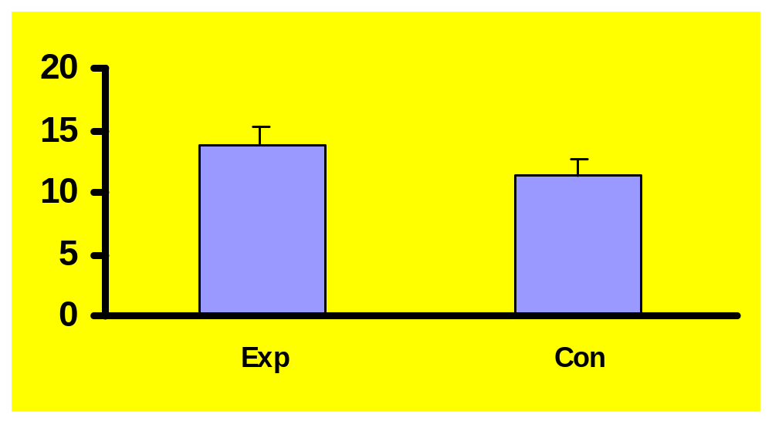
Figure 4. Descriptive statistics of VGRF.

Slide 52
SD and the normal curve
About 68% of
scores fall
within 1 SD
of mean
X = 70
SD = 10
34%
34%
60
70
80

Slide 53
The standard deviation and the normal curve
About 68% of
scores fall
between 60 and 70
X = 70
SD = 10
34%
34%
60
70
80

Slide 54
The standard deviation and the normal curve
About 95% of
scores fall
within 2 SD
of mean
X = 70
SD = 10
50
60
70
80
90

Slide 55
The standard deviation and the normal curve
About 95% of
scores fall
between 50 and 90
X = 70
SD = 10
50
60
70
80
90

Slide 56
The standard deviation and the normal curve
About 99.7% of scores fall within 3 S.D. of the mean
X = 70
SD = 10
40
50
60
70
80
90
100

Slide 57
The standard deviation and the normal curve
About 99.7% of scores fall between 40 and 100
X = 70
SD = 10
40
50
60
70
80
90
100

Slide 58
What about X = 70, SD = 5?
What approximate percentage of scores fall between 65 & 75?
What range includes about 99.7% of all scores?

Slide 59
Descriptive statistics for a normal population
n
Mean
SD
Allows you to formulate the limits (range) including
a certain percentage (Y%) of all scores.
Allows rough comparison of different sets of scores.
More on the SD and the Normal Curve

Slide 60
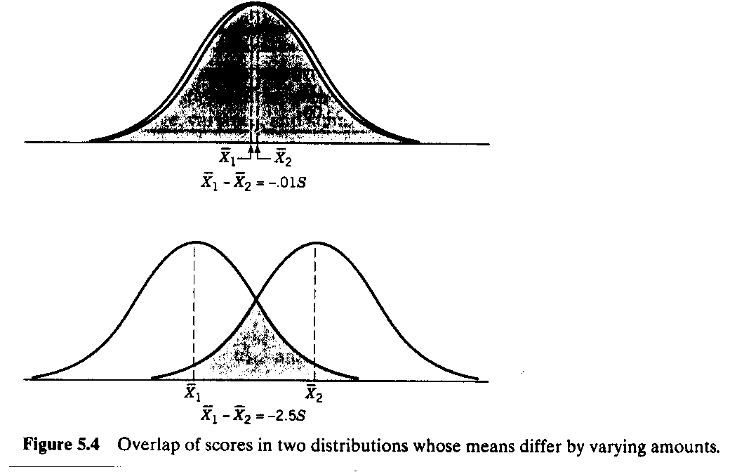
Comparing Means
Relevance of Variability

Slide 61
Effect Size
Mean Difference as % of SD
Small: 0.2 SD
Medium: 0.5 SD
Large: 0.8 SD
Cohen (1988)

Slide 62
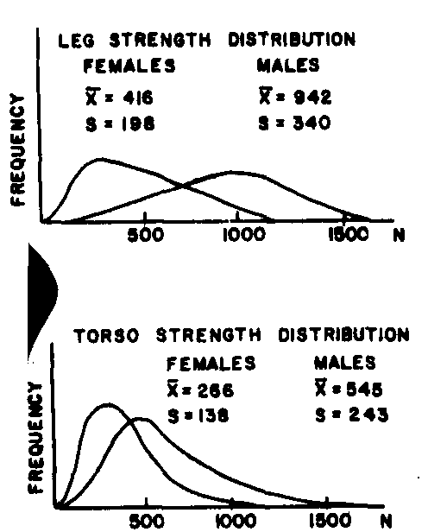
Male
&
Female
Strength

Slide 63
Pooled Standard Deviation
If two samples have similar, but not
identical standard deviations
SS₁ + SS₂
Sd_{pooled}=
n₁ + n₂
Sd₁ + Sd₂
Sd_{pooled}~
2
or

Slide 64
Male
&
Female
Strength
Sd_{pooled} = 198+340
2
= 269
Mean Difference = 416-942
= -526
Effect Size = -526/269 = -1.96

Slide 65
ABOUT
Area under Normal Curve
  Specific SD values (z) including certain percentages of the scores
  Values of Special Interest
    1.96 SD = 47.5% of scores (95%)
    2.58 SD = 49.5% of scores (99%)
http://psych.colorado.edu/~mcclella/java/normal/tableNormal.html
Quebec Hydro article

Slide 66
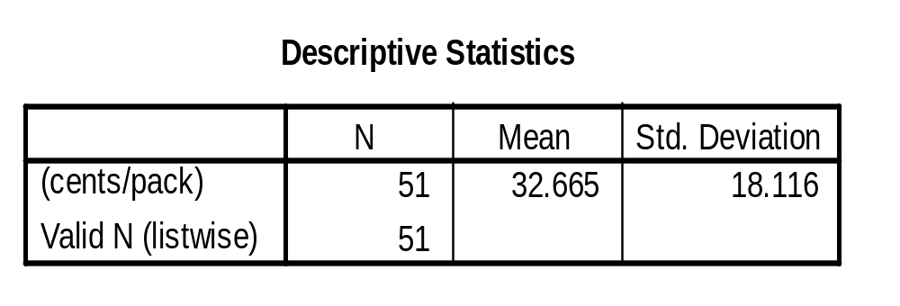
What upper and lower limits
include 95% of scores?

Slide 67
Standard Scores
Comparing scores across (normal) distributions
  “z-scores”

Slide 68
Assessing the relative position of a single score
Move from describing a distribution to looking at how a single score fits into the group
  Raw Score: a single individual value
    ie 36 in exam scores
How to interpret this value??

Slide 69
Descriptive Statistics
Mean
SD
n
Describe the “typical”
and the “spread”, and
the number of cases

Slide 70
Descriptive Statistics
Mean
SD
n
Describe the “typical”
and the “spread”, and
the number of cases
z-score
identifies a score as above or below the mean AND expresses a score in units of SD
  z-score = 1.00 (1 SD above mean)
  z-score = -2.00 (2 SD below mean)

Slide 71
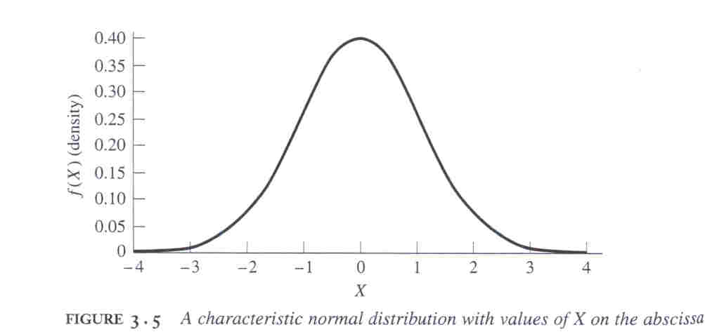
Z-score = 1.0
GRAPHICALLY
84% of scores smaller than this
Z = 1

Slide 72
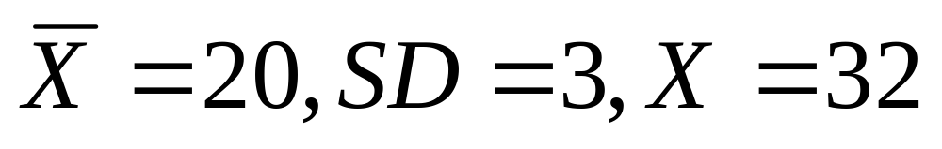
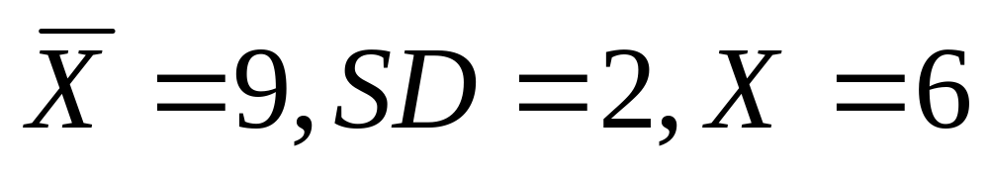
Calculating z-scores
X - X
Deviation
Score
Z =
SD
Calculate Z for each of the following situations:

Slide 73
Other features of z-scores
Mean of distribution of z-scores is equal to 0 (ie 0 = 0 SD)
Standard deviation of distribution of z-scores = 1
  since SD is unit of measurement
z-score distribution is same shape as raw score distribution
data from atable41.sav

Slide 74
Z-scores: allow comparison of scores from different distributions
Mary’s score
  SAT Exam 450 (mean 500 SD 100)
Gerald’s score
  ACT Exam 24 (mean 18 SD 6)
Who scored higher?
Mary: (450 – 500)/100 = - .5
Gerald: (24 – 18)/6 = 1

Slide 75
Interesting use of z-scores:
Compare performance on different measures
ie Salary vs Homeruns
  MLB (n = 22, June 1994)
    Mean salary = $2,048,678
      SD = $1,376,876
    Mean HRs = 11.55
      SD = 9.03
  Frank Thomas
    $2,500,000, 38 HRs

Slide 76
More z-score & bell-curve
For any z-score, we can calculate the percentage of scores between it and the mean of the normal curve; between it and all scores below; between it and all scores above
  Applet demos:
    http://psych.colorado.edu/~mcclella/java/normal/normz.html
    http://psych.colorado.edu/~mcclella/java/normal/handleNormal.html
    http://psych.colorado.edu/~mcclella/java/normal/tableNormal.html

Slide 77
Recall, when z-score = 1.0 ...
50%
34.13%

Slide 78
% scores above z = 1.0
15.87%
50%
34.13%

Slide 79
If z-score = 1.2
What %
in here?
50%
X
1.2 SD

